Slide 1
Theory of Computation
Dr. Sujit Kumar Das

Slide 2
What is Theory of Computation?
Definition (simple):
Theory of Computation is the study of mathematical models of computation and their capabilities and limitations.
Definition (formal):
Theory of Computation analyzes abstract machines and formal languages to determine:
Computability (whether a problem can be solved)
Efficiency (how much time and memory are required)
Decidability (whether a problem can always be answered)

Slide 3
Why Do We Study Theory of Computation?
Theory of Computation helps answer:
Can a problem be solved by any algorithm?
If yes, can it be solved efficiently?
If not, why not?
Theory of Computation is broadly divided into three interconnected parts:
Automata Theory
Studies abstract machines
Focuses on language recognition

Slide 4
Formal Language Theory
Studies sets of strings (languages)
Used in compiler design and syntax analysis
Examples:
Regular Languages
Context-Free Languages
Computability & Complexity Theory
Studies limitations of computation
Classifies problems based on difficulty
Examples:
Decidable vs Undecidable problems
P, NP, NP-Complete

Slide 5
What is an Automaton?
Simple definition:
An automaton is an abstract machine that reads an input string symbol by symbol, changes its state according to fixed rules, and finally accepts or rejects the input.
Formal idea:
An automaton is a mathematical model used to recognize languages.

Slide 6
Why Do We Need Automata?
To Understand What Computers Can and Cannot Do
To Model Computation in a Simple and Precise Way
Remove unnecessary hardware details
Focus only on input, memory, and control
To Study Different Levels of Computational Power
Different automata have different memory:
Automaton | Memory | Power
Finite Automaton | Finite states | Least
Pushdown Automaton | Stack | Moderate
Turing Machine | Infinite tape | Maximum

Slide 7
Why Do We Need Automata?
To Recognize and Classify Languages
Decide whether a string belongs to a language
Classify languages into:
Regular
Context-Free
Recursively Enumerable
This classification is essential in:
Compiler design
Syntax analysis
Language design

Slide 8
Why Do We Need Automata?
To Design Real Systems Used in Practice
Finite Automata → Lexical analyzers, pattern matching
Pushdown Automata → Syntax parsers
Turing Machines → Model of general-purpose computers
Regular expressions → Text search, intrusion detection
To Prove Some Problems Are Impossible to Solve
Undecidable problems
Example: Halting Problem
To Analyze Efficiency and Complexity
Time complexity, Space complexity
Complexity classes (P, NP)

Slide 9
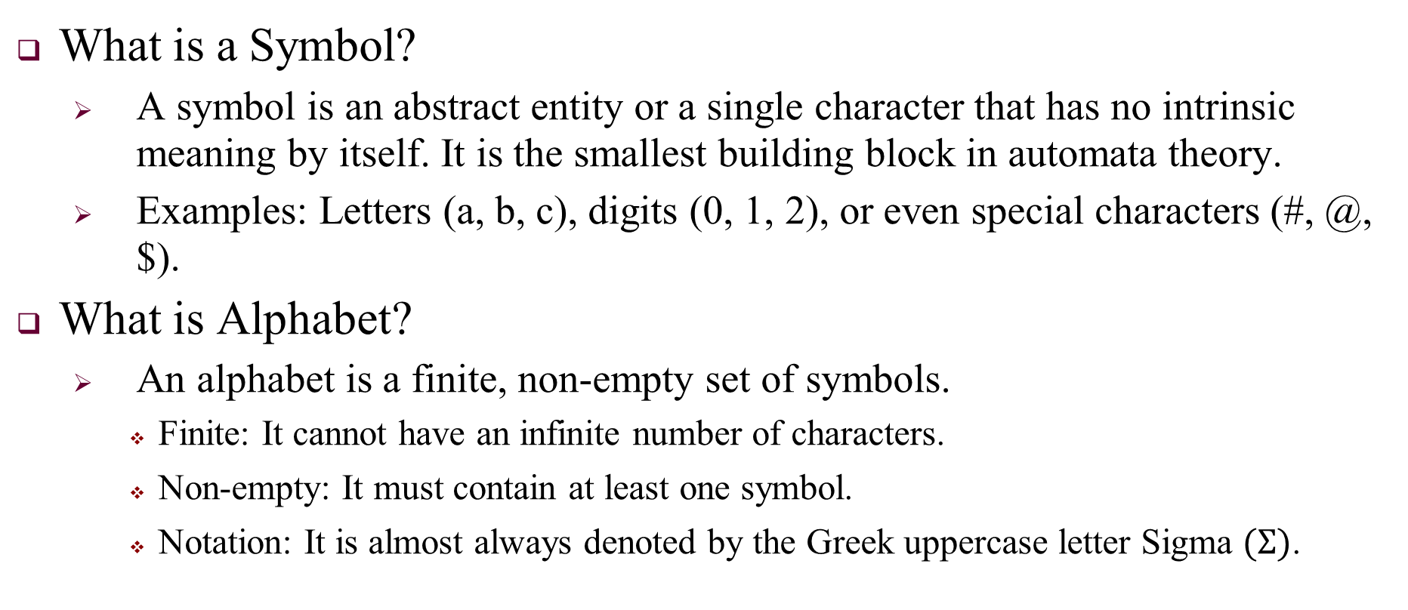
Symbols and Alphabet
What is a Symbol?
A symbol is an abstract entity or a single character that has no intrinsic meaning by itself. It is the smallest building block in automata theory.
Examples: Letters (a, b, c), digits (0, 1, 2), or even special characters (#, @, $).
What is Alphabet?
An alphabet is a finite, non-empty set of symbols.
Finite: It cannot have an infinite number of characters.
Non-empty: It must contain at least one symbol.
Notation: It is almost always denoted by the Greek uppercase letter Sigma $(Σ)$.

Slide 10
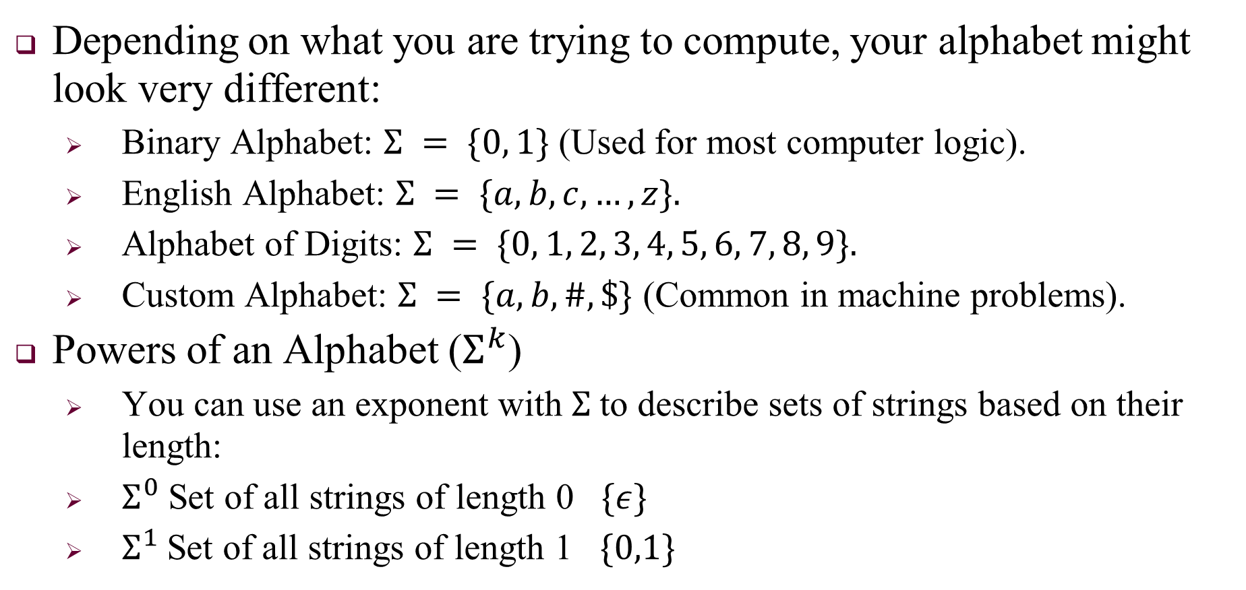
Alphabet
Depending on what you are trying to compute, your alphabet might look very different:
Binary Alphabet: $Σ = \{0, 1\}$ (Used for most computer logic).
English Alphabet: $Σ = \{a, b, c, …, z\}.$
Alphabet of Digits: $Σ = \{0, 1, 2, 3, 4, 5, 6, 7, 8, 9\}.$
Custom Alphabet: $Σ = \{a, b, \#, \$\}$ (Common in machine problems).
Powers of an Alphabet ($Σ^{k}$)
You can use an exponent with $Σ$to describe sets of strings based on their length:
$Σ^{0}$Set of all strings of length 0 $\{ε\}$
$Σ^{1}$Set of all strings of length 1 $\{0,1\}$

Slide 11
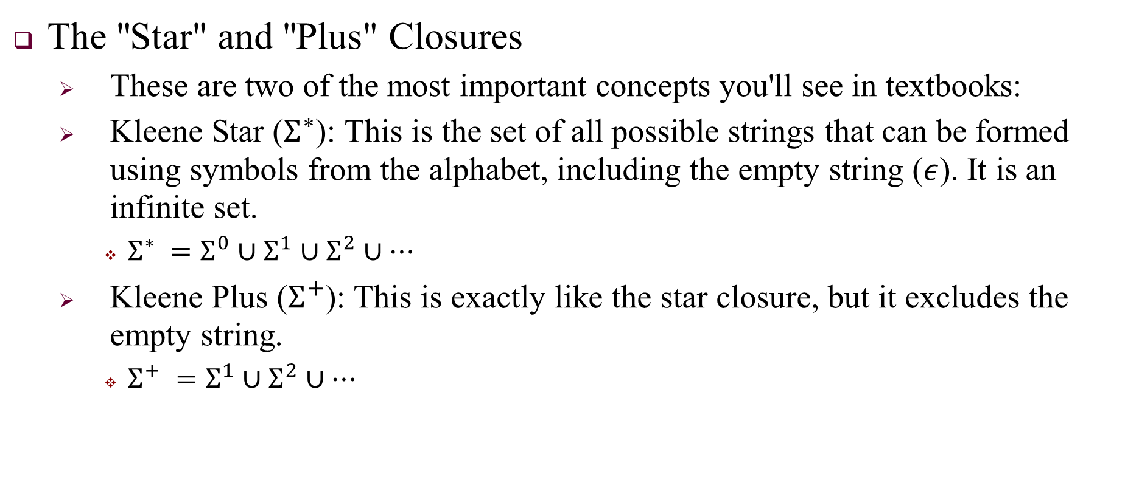
Alphabet
The "Star" and "Plus" Closures
These are two of the most important concepts you'll see in textbooks:
Kleene Star ($Σ^{∗}$): This is the set of all possible strings that can be formed using symbols from the alphabet, including the empty string ($ε$). It is an infinite set.
$Σ^{∗} =Σ^{0}∪Σ^{1}∪Σ^{2}∪…$
Kleene Plus ($Σ^{+}$): This is exactly like the star closure, but it excludes the empty string.
$Σ^{+} =Σ^{1}∪Σ^{2}∪…$

Slide 12
Strings: Sequence of Symbols
A string is what you get when you combine symbols from an alphabet in a sequence
A string over an alphabet Σ is a finite sequence of symbols from Σ.

Slide 13
Languages: Set of Strings
A single string is one input. A language is all valid inputs together
A language over alphabet Σ is a set of strings formed from Σ.

